Slide 1
EE550 Project Datacenter Network Analysis
Wanwiset Peerapatanapokin

Slide 2
Problem Description
Traditionally, datacenter networks follow a 3 layer model. This includes the access layer, distribution layer and core layer.
An example of this model is shown below
Internet
1
2
Core layer
3
4
5
6
Distribution layer
7
8
9
10
11
12
Access layer (Top of rack switches)

Slide 3
Problem Description
In recent years, cloud computing became highly popular. This creates a demand towards East-West traffic (communication within the datacenter itself)
To accommodate this, the new spine and leaf network design was introduced.
Internet
1
2
3
Spine
4
5
6
7
8
9
Leaf (top of rack switches)

Slide 4
Problem Description
We want to explore how effective the spine and leaf model is, compared to traditional model
One technique we learned is the Drift-Plus-Penalty (DPP) algorithm. It utilizes a virtual queue to simulate the convex program.
MATLAB is also used to simulate the algorithm and obtain numerical results.

Slide 5
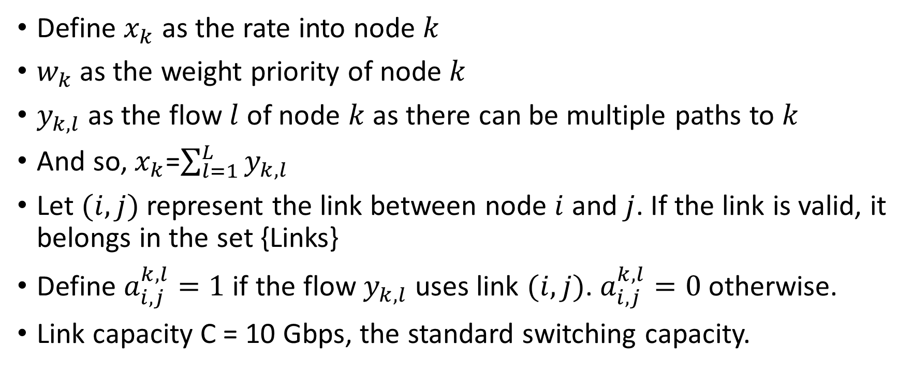
Problem formulation
Define $x_{k}$ as the rate into node $k$
$w_{k}$ as the weight priority of node $k$
$y_{k,l}$ as the flow $l$ of node $k$ as there can be multiple paths to $k$
And so, $x_{k}$=$\sum_{l=1}^{L}{y_{k,l}}$
Let $(i,j)$ represent the link between node $i$ and $j$. If the link is valid, it belongs in the set {Links}
Define $a_{i,j}^{k,l}=1$if the flow $y_{k,l}$ uses link $(i,j)$. $a_{i,j}^{k,l}=0$otherwise.
Link capacity C = 10 Gbps, the standard switching capacity.

Slide 6
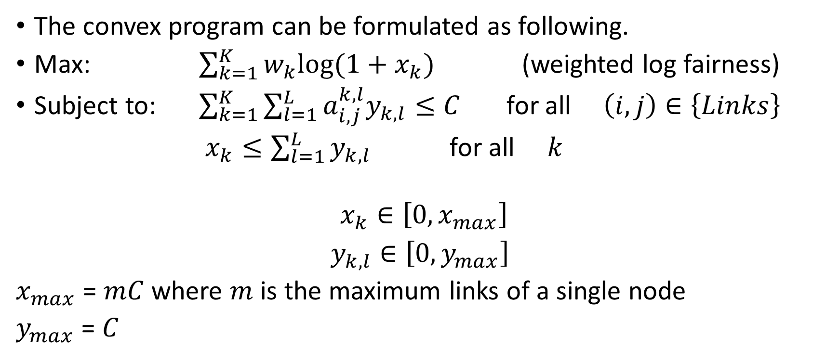
Problem formulation
The convex program can be formulated as following.
Max: $\sum_{k=1}^{K}{w_{k}log⁡(1+x_{k})}$ (weighted log fairness)
Subject to: $\sum_{k=1}^{K}{\sum_{l=1}^{L}{{a_{i,j}^{k,l}y}_{k,l}}≤C}$ for all $\left(i,j\right)∈\left\{Links\right\}$
$x_{k}≤\sum_{l=1}^{L}{y_{k,l}}$ for all $k$
$$x_{k}∈\left[0, x_{max}\right]$$
$y_{k,l}∈\left[0, y_{max}\right]$
$x_{max}$ = $mC$ where $m$ is the maximum links of a single node
$y_{max}$ = $C$

Slide 7

Problem formulation
Define virtual queues
$Q_{i,j}\left(t+1\right)=max⁡[Q_{i,j}\left(t\right)+\sum_{k=1}^{K}{\sum_{l=1}^{L}{{a_{i,j}^{k,l}y}_{k,l}}−C},0]$
$Z_{k}\left(t+1\right)=max⁡[Z_{k}\left(t\right)+x_{k}(t)−\sum_{l=1}^{L}{y_{k,l}}(t),0]$

Slide 8
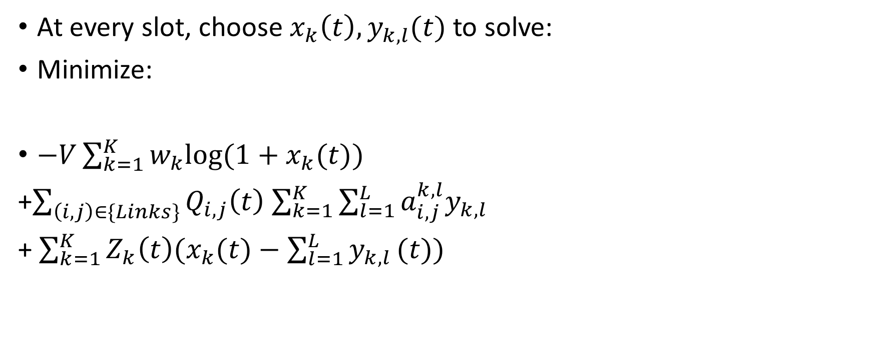
Problem formulation
At every slot, choose $x_{k}\left(t\right),y_{k,l}(t)$ to solve:
Minimize:
$−V\sum_{k=1}^{K}{w_{k}log⁡(1+x_{k}(t))}$
+$\sum_{\left(i,j\right)∈\{Links\}}{Q_{i,j}\left(t\right)}$ $\sum_{k=1}^{K}{\sum_{l=1}^{L}{{a_{i,j}^{k,l}y}_{k,l}}}$
+ $\sum_{k=1}^{K}{Z_{k}\left(t\right){(x}_{k}(t)−\sum_{l=1}^{L}{y_{k,l}}(t))}$

Slide 9
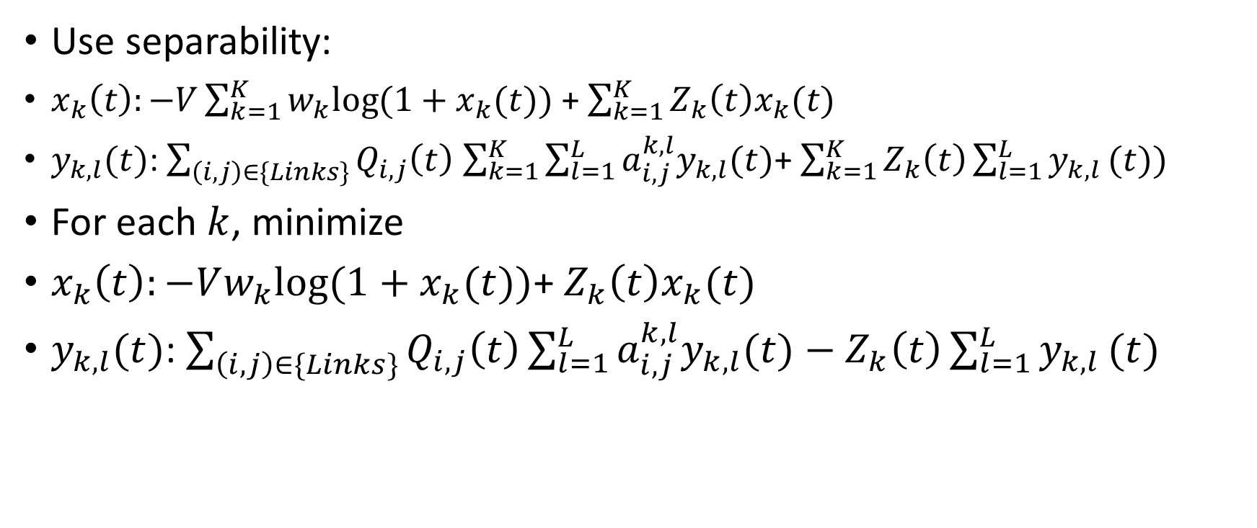
Problem formulation
Use separability:
$x_{k}\left(t\right):−V\sum_{k=1}^{K}{w_{k}log⁡(1+x_{k}(t))}$ + $\sum_{k=1}^{K}{Z_{k}\left(t\right)x_{k}(t)}$
$y_{k,l}(t)$: $\sum_{\left(i,j\right)∈\{Links\}}{Q_{i,j}\left(t\right)}$ $\sum_{k=1}^{K}{\sum_{l=1}^{L}{{a_{i,j}^{k,l}y}_{k,l}(t)}}$+ $\sum_{k=1}^{K}{Z_{k}\left(t\right)\sum_{l=1}^{L}{y_{k,l}}(t))}$
For each $k$, minimize
$x_{k}\left(t\right):−Vw_{k}log⁡(1+x_{k}(t))$+ $Z_{k}\left(t\right)x_{k}(t)$
$y_{k,l}(t)$: $\sum_{\left(i,j\right)∈\{Links\}}{Q_{i,j}\left(t\right)}\sum_{l=1}^{L}{{a_{i,j}^{k,l}y}_{k,l}(t)}−$ $Z_{k}\left(t\right)\sum_{l=1}^{L}{y_{k,l}}(t)$

Slide 10

Problem formulation
$x_{k}\left(t\right):−Vw_{k}log⁡(1+x_{k}(t))$ $Z_{k}\left(t\right)x_{k}(t)$
$\frac{d}{dx_{k}\left(t\right)}$ $→$ $−Vw_{k}$ $\frac{1}{1+x_{k}(t)}$+ $Z_{k}\left(t\right)=0$
$$x_{k}\left(t\right)=\left[\frac{Vw_{k}}{Z_{k}\left(t\right)}−1\right]{x_{max} \atop 0}$$

Slide 11
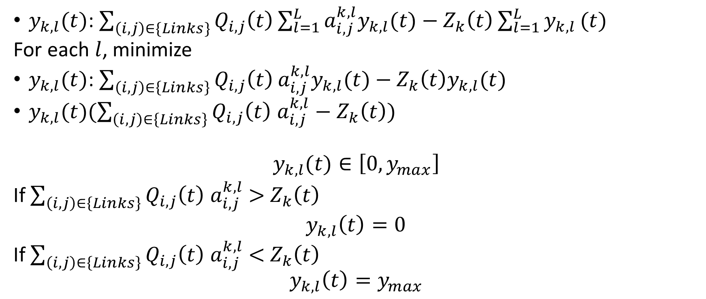
Problem formulation
$y_{k,l}(t)$: $\sum_{\left(i,j\right)∈\{Links\}}{Q_{i,j}\left(t\right)}\sum_{l=1}^{L}{{a_{i,j}^{k,l}y}_{k,l}(t)}−$ $Z_{k}\left(t\right)\sum_{l=1}^{L}{y_{k,l}}(t)$
For each $l$, minimize
$y_{k,l}(t)$: $\sum_{\left(i,j\right)∈\left\{Links\right\}}{Q_{i,j}\left(t\right)}{a_{i,j}^{k,l}y}_{k,l}(t)−$ $Z_{k}\left(t\right)y_{k,l}(t)$
$y_{k,l}(t)(\sum_{\left(i,j\right)∈\left\{Links\right\}}{Q_{i,j}\left(t\right)}$ $a_{i,j}^{k,l}$ $−$ $Z_{k}\left(t\right))$
$$y_{k,l}(t)∈\left[0, y_{max}\right]$$
If $\sum_{\left(i,j\right)∈\left\{Links\right\}}{Q_{i,j}\left(t\right)}$ $a_{i,j}^{k,l}$ $>$ $Z_{k}\left(t\right)$
$y_{k,l}\left(t\right)=0$
If $\sum_{\left(i,j\right)∈\left\{Links\right\}}{Q_{i,j}\left(t\right)}$ $a_{i,j}^{k,l}$ $<$ $Z_{k}\left(t\right)$
$$y_{k,l}\left(t\right)=y_{max}$$

Slide 12
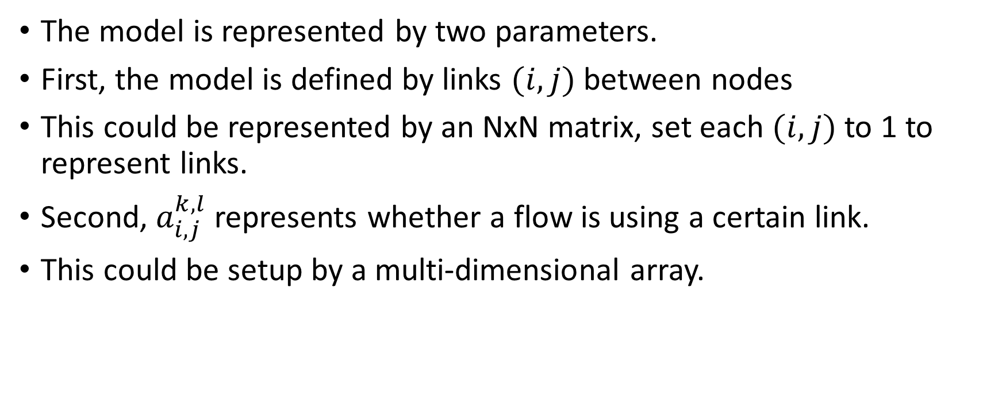
Simulation setup
The model is represented by two parameters.
First, the model is defined by links $(i,j)$ between nodes
This could be represented by an NxN matrix, set each $(i,j)$ to 1 to represent links.
Second, $a_{i,j}^{k,l}$ represents whether a flow is using a certain link.
This could be setup by a multi-dimensional array.

Slide 13

Performance Comparison East-West traffic
Case 1: Single node download, traditional model
Let 7 download from 10, what is the simulation result for maximum throughput?
$x_{7}=19.319$Gbps
1
2
3
4
5
6
7
8
9
10
11
12

Slide 14

Performance Comparison East-West traffic
Case 1: Single node download, spine-leaf model
Let 4 download from 7, what is the simulation result for maximum throughput?
$x_{4}=29.4985$Gbps
1
2
3
4
5
6
7
8
9

Slide 15
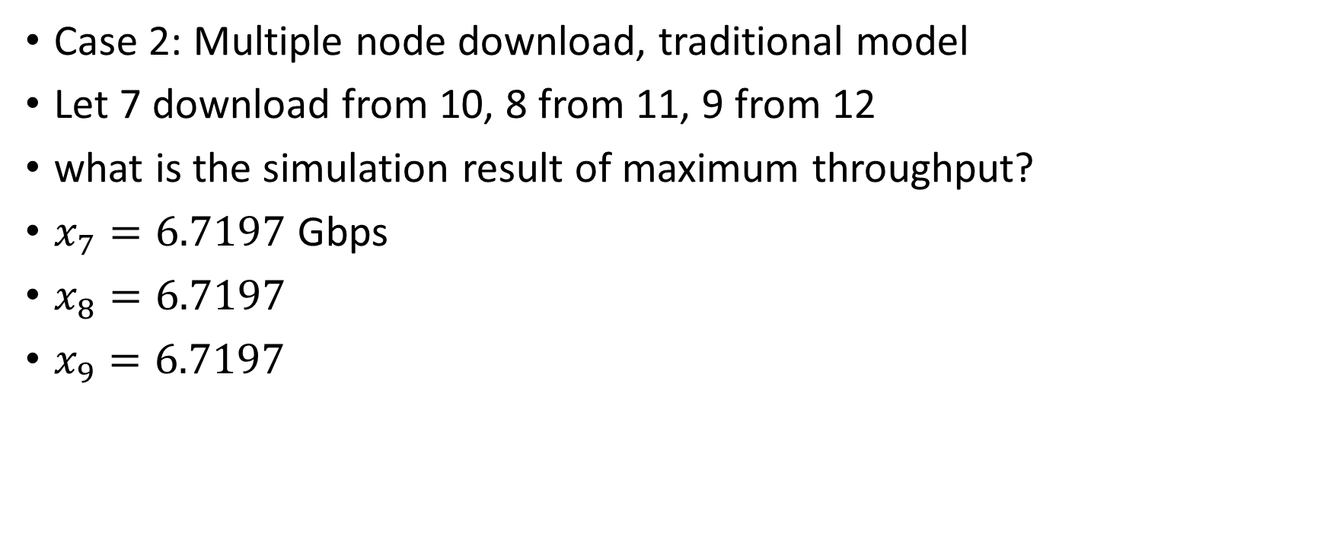
Performance Comparison East-West traffic
Case 2: Multiple node download, traditional model
Let 7 download from 10, 8 from 11, 9 from 12
what is the simulation result of maximum throughput?
$x_{7}=6.7197$Gbps
$x_{8}=6.7197$
$x_{9}=6.7197$
1
2
3
4
5
6
7
8
9
10
11
12

Slide 16

Performance Comparison East-West traffic
Case 2: Multiple node download, spine-leaf model
Let 4 download from 7, 5 from 8, 6 from 9
what is the simulation result of maximum throughput?
$x_{4}=29.4985$Gbps
$x_{5}=29.4985$
$x_{6}=29.4985$
1
2
3
4
5
6
7
8
9

Slide 17
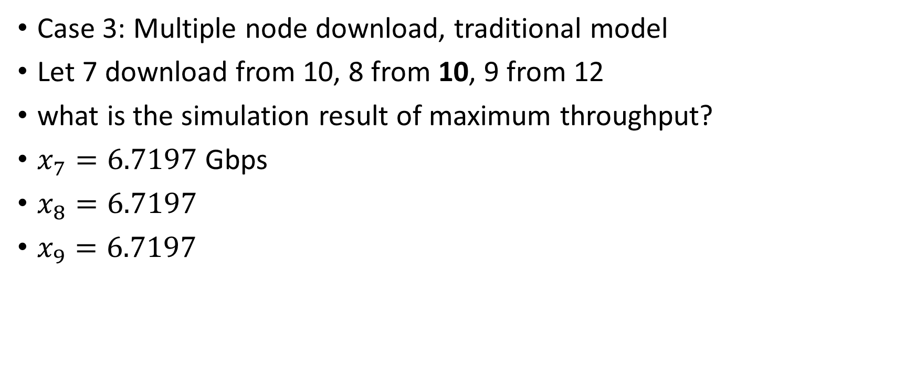
Performance Comparison East-West traffic
Case 3: Multiple node download, traditional model
Let 7 download from 10, 8 from 10, 9 from 12
what is the simulation result of maximum throughput?
$x_{7}=6.7197$Gbps
$x_{8}=6.7197$
$x_{9}=6.7197$
1
2
3
4
5
6
7
8
9
10
11
12

Slide 18

Performance Comparison East-West traffic
Case 3: Multiple node download, spine-leaf model
Let 4 download from 7, 5 from 7, 6 from 9
what is the simulation result of maximum throughput?
$x_{4}=14.9993$Gbps
$x_{5}=14.9993$
$x_{6}=29.4985$
1
2
3
4
5
6
7
8
9

Slide 19

Performance Comparison North-bound traffic
Case 1: Single node download, traditional model
Let 7 download from the Internet
what is the simulation result of maximum throughput?
$x_{7}=19.499$Gbps
Internet
1
2
3
4
5
6
7
8
9
10
11
12

Slide 20

Performance Comparison North-bound traffic
Case 1: Single node download, spine-leaf model
Let 4 download from the Internet
what is the simulation result of maximum throughput?
$x_{4}=9.9995$Gbps
Internet
1
2
3
4
5
6
7
8
9

Slide 21
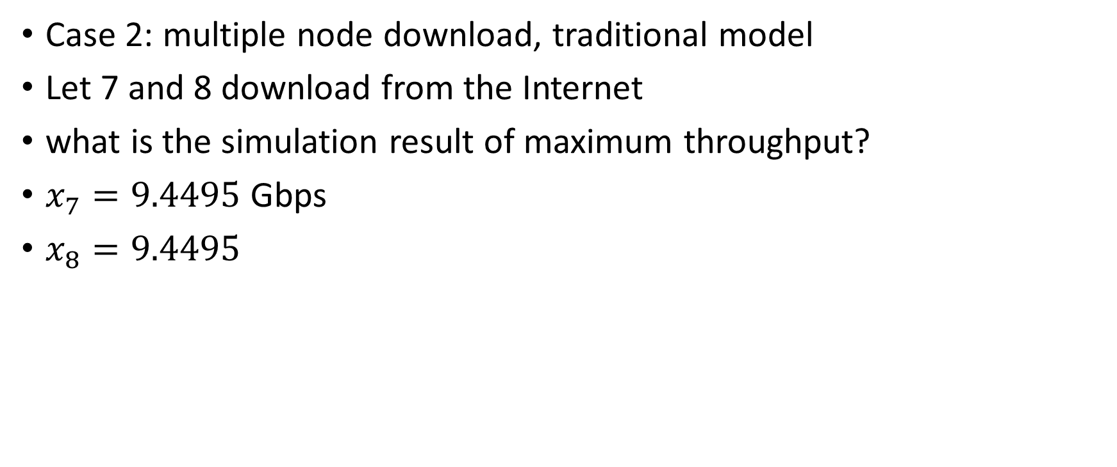
Performance Comparison North-bound traffic
Case 2: multiple node download, traditional model
Let 7 and 8 download from the Internet
what is the simulation result of maximum throughput?
$x_{7}=9.4495$Gbps
$x_{8}=9.4495$
Internet
1
2
3
4
5
6
7
8
9
10
11
12

Slide 22

Performance Comparison North-bound traffic
Case 2: multiple node download, spine-leaf model
Let 4 and 5 download from the Internet
what is the simulation of maximum throughput?
$x_{4}=9.9995$Gbps
$x_{5}=9.9995$
Internet
1
2
3
4
5
6
7
8
9

Slide 23
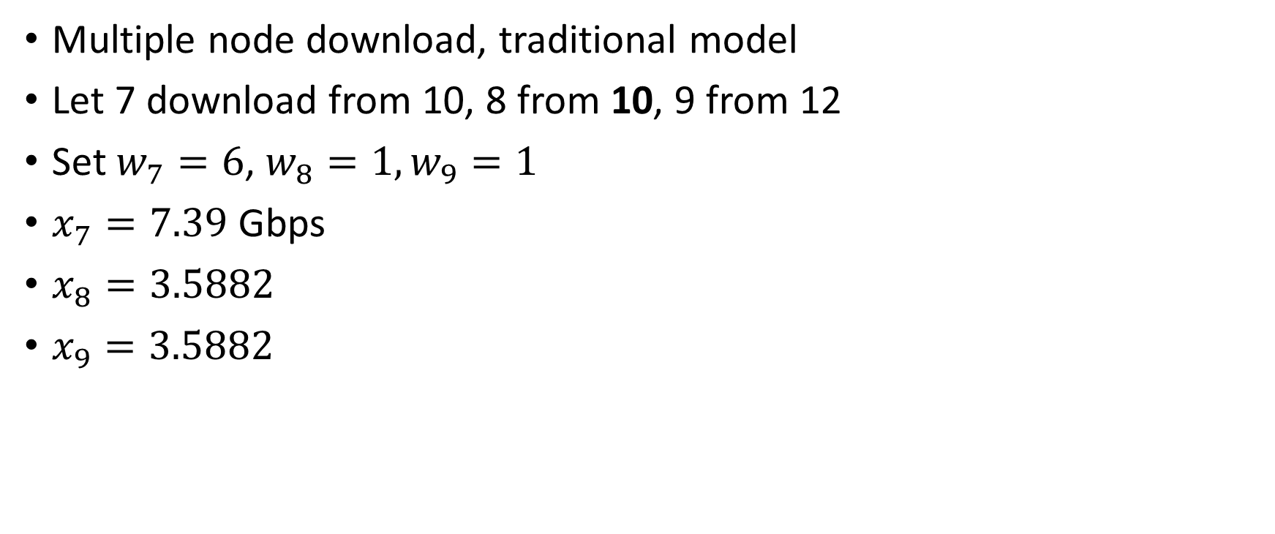
Weighted Performance Comparison
Multiple node download, traditional model
Let 7 download from 10, 8 from 10, 9 from 12
Set $w_{7}=6$, $w_{8}=1,w_{9}=1$
$x_{7}=7.39$Gbps
$x_{8}=3.5882$
$x_{9}=3.5882$
1
2
3
4
5
6
7
8
9
10
11
12

Slide 24

Weighted Performance Comparison
Multiple node download, spine-leaf model
Let 4 download from 7, 5 from 7, 6 from 9
Set $w_{4}=1$, $w_{5}=2,w_{6}=1$
$x_{4}=12.8066$Gbps
$x_{5}=16.8094$
$x_{6}=29.4189$
1
2
3
4
5
6
7
8
9

Slide 25
Conclusion
The new Spine and Leaf model performs much better in East-West throughput, as it was designed to solve this problem
However in a single node Internet download, the traditional network has better throughput. This is the main tradeoff when considering which network architecture to use
Spine and Leaf model solves cloud computing problems, where there is demand for communication within the same datacenter
Traditional model solves server hosting or web hosting problems, where there is demand for connecting with the internet.
The DPP algorithm derived is not limited to these models. It can be used in any general topology with defined flow paths and link capacity constraints

